Slide 1
POG: Personalized Outfit Generation for Fashion Recommendation at Alibaba iFashion
KDD 2019
Notes:
https://developer.aliyun.com/live/1388

Slide 2
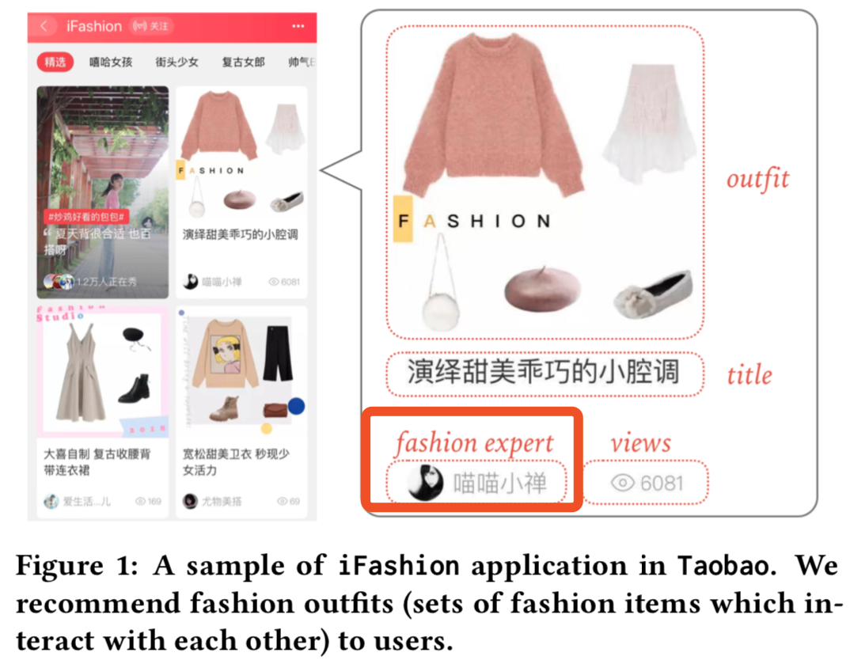
Motivation
Outfit由专家手动生成。
劳动力的限制和日益增长的市场需求。
Compatibility
early study：主要学习成对items之间的搭配性准则/预测一个outfit的流行度
recent work：把outfit建模为一个items的有序序列来生成outfits
Personalization
依赖于用户提供的显式输入（搜索）
CF关注单一items的推荐而不是outfits

Slide 3
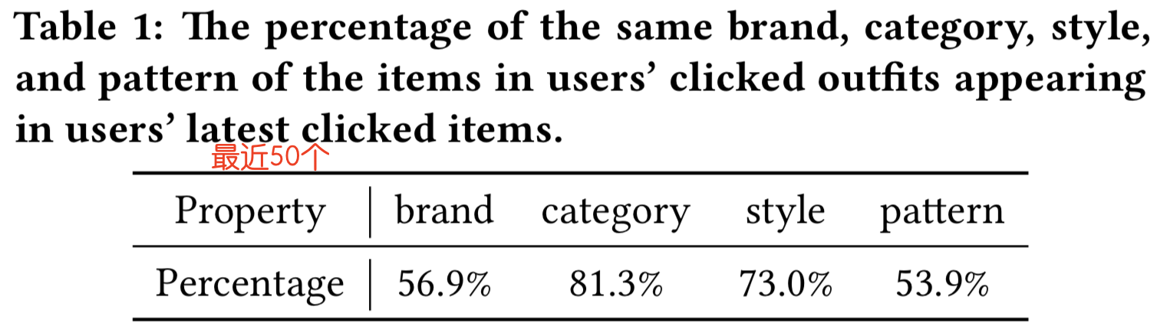
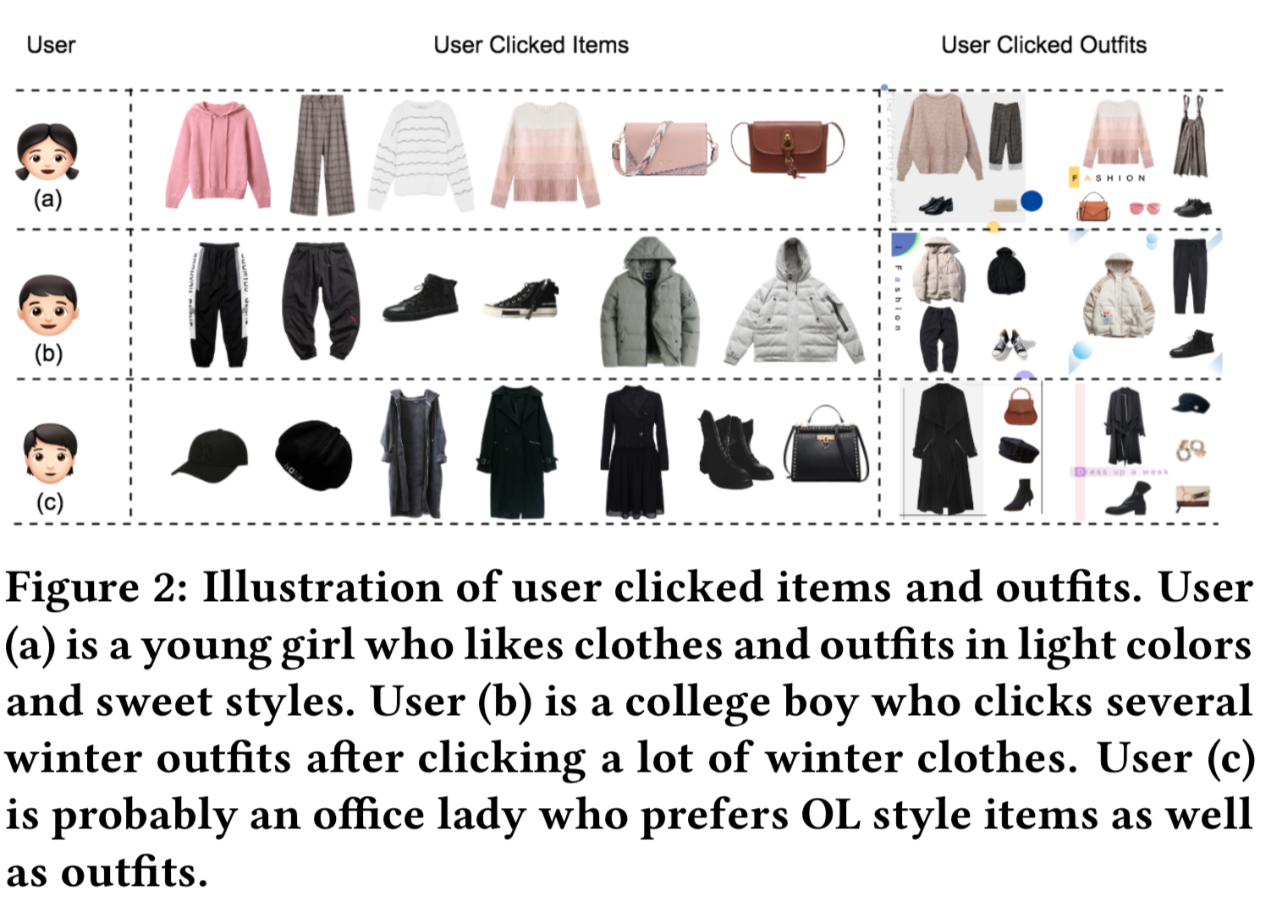
Data analysis
people have similar tastes in individual items and outfits

Slide 4
Main work
Compatibility requirement
Fashion Outfit Model (FOM)
Personalization requirement
Personalized Outfit Generation (POG) model
this is the first study to generate personalized outfits based on users’ historical behaviors with an encoder-decoder framework

Slide 5
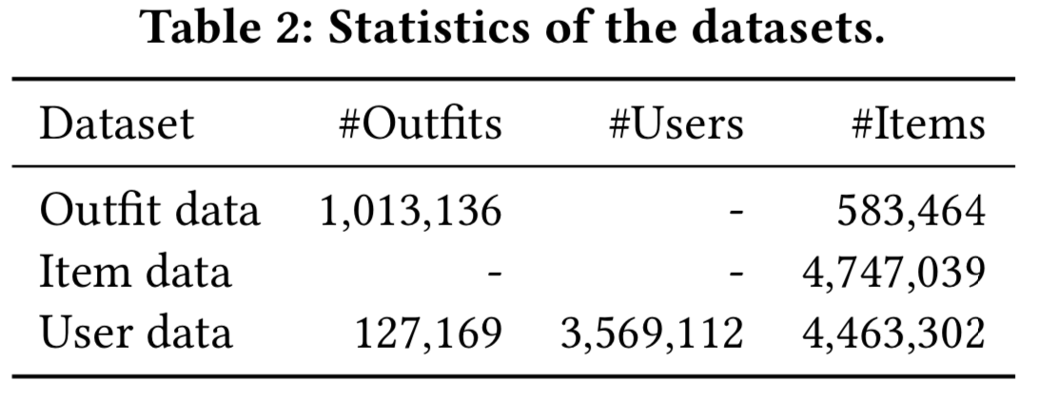
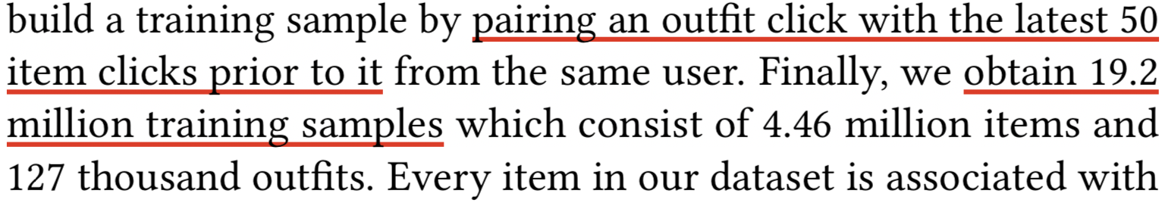
Dataset
收集80个最频繁的类别；过滤掉少于4个item的outfits；活跃的用户：看过多于40个outfits；
仅当同一用户之前点击>10次的items时，才会记录outfits的点击。
最大的公开数据集
第一个提供outfit data和相关的用户行为data的数据集

Slide 6
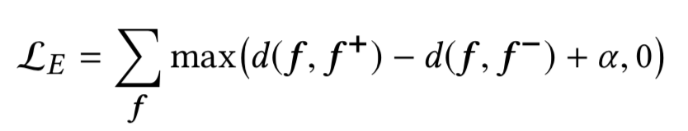
Step 1 ：Multi-modal Embedding
3 input：
CNN： dense vector encoding the white background picture
TextCNN： dense vector encoding the title（TextCNN已被预训练-基于title预测item的子类别）
Alibaba Behemoth Graph Embedding platform： dense vector encoding a collaborative filtering signal for the item
Concatenate 3 input ->全连接层
Output：一个d_{e}维的向量f
Triplet loss：f和f+的距离小于f和f-的距离
Notes:
margin

Slide 7
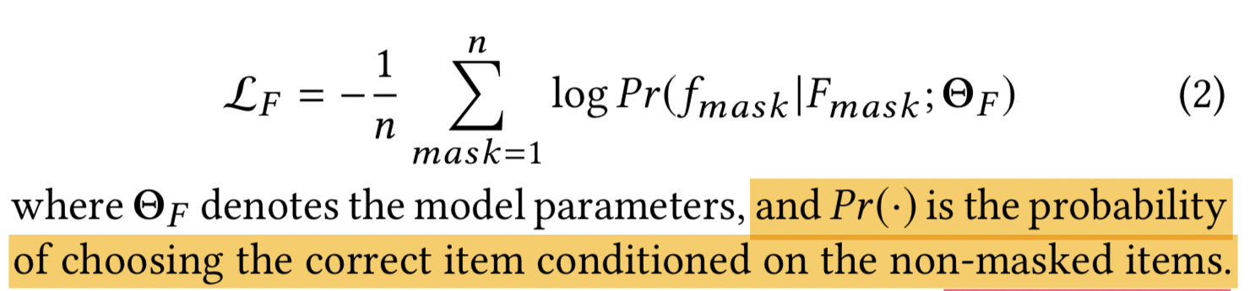
Step 2 ：FOM-Fashion Outfit Model
Item和outfit的其他items之间应有不同的权重相互作用
基于双向Transformer架构设计一个掩盖item预测任务。
Notes:
mask word prediction Bert中predict masked item的pretrain
outfit中的items是无序的，不需要添加position embedding

Slide 8
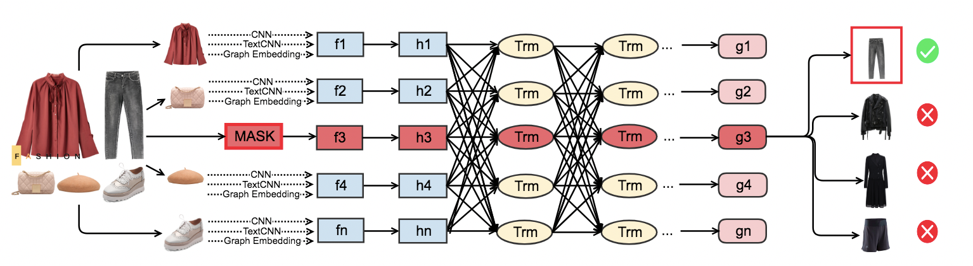
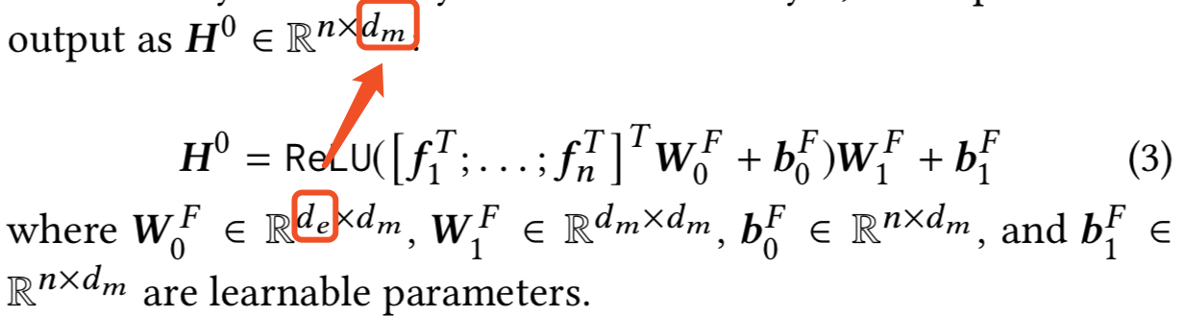
Step 2 ：FOM-Fashion Outfit Model
过渡层：F_{mask}通过2个全连接层

Slide 9
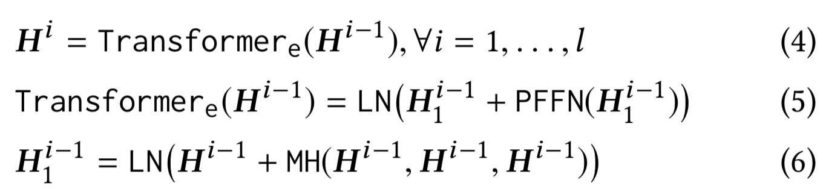
Step 2 ：FOM-Fashion Outfit Model

Slide 10
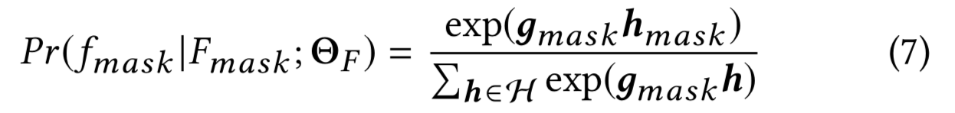
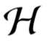

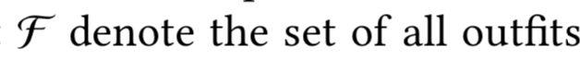
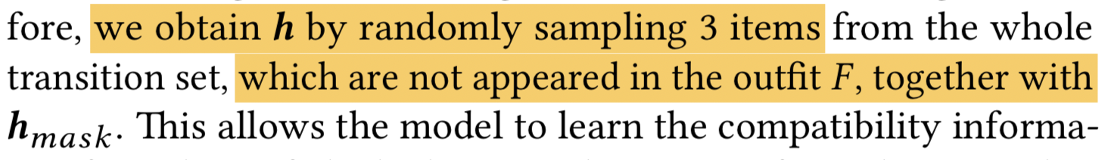
Step 2 ：FOM-Fashion Outfit Model
h_{mask}: ground truth transition embedding of the masked item
contains the transition embeddings from all the items in

Slide 11
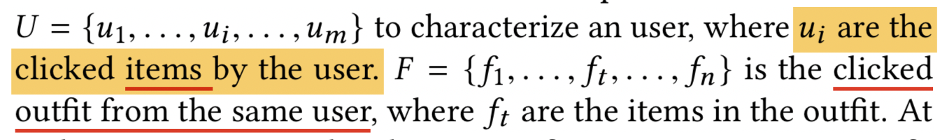
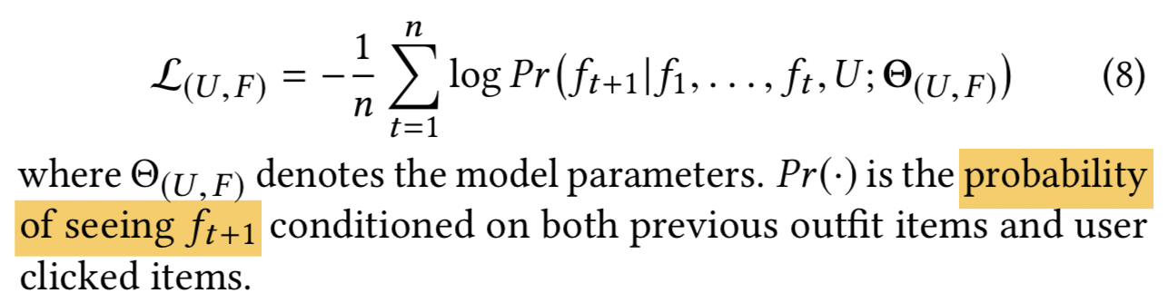
Step 3 ：POG: Personalized Outfit Generation Model
目标：generates personalized and compatible outfit
解析历史行为，添加个性化需求

Slide 12
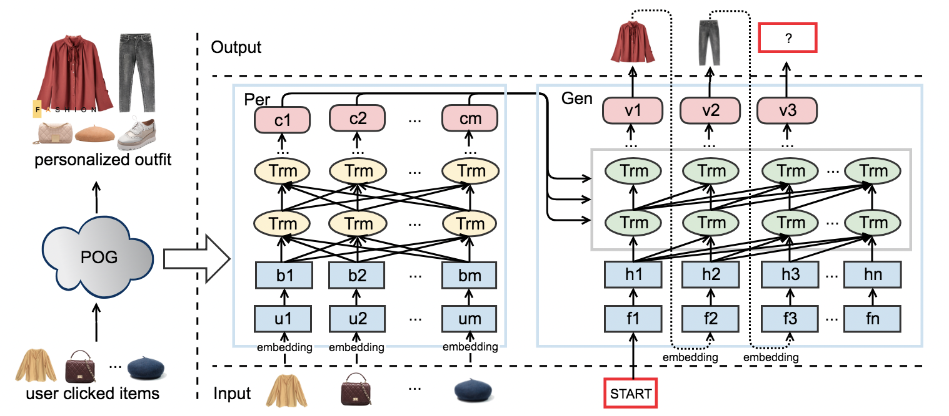
Step 3 ：POG: Personalized Outfit Generation Model
Encoder: Per网络，提供用户偏好信号
Decoder：Gen网络，基于个性化信号和兼容性信号 生成outfits

Slide 13
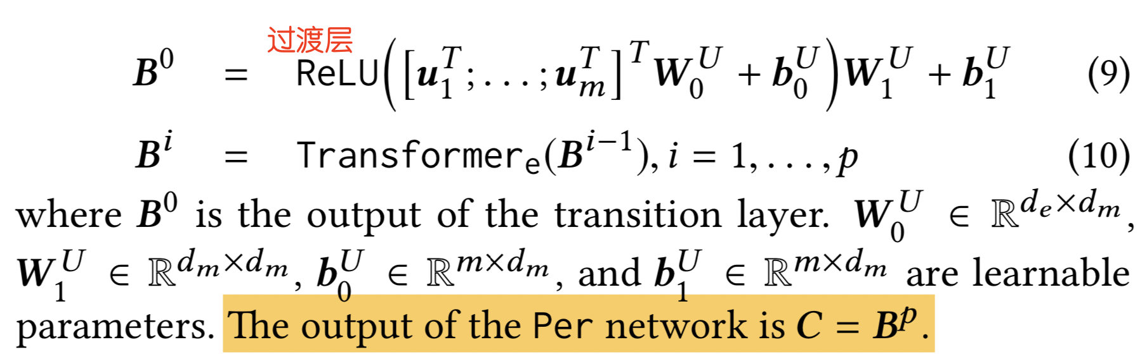
Step 3 ：POG: Personalized Outfit Generation Model

Slide 14
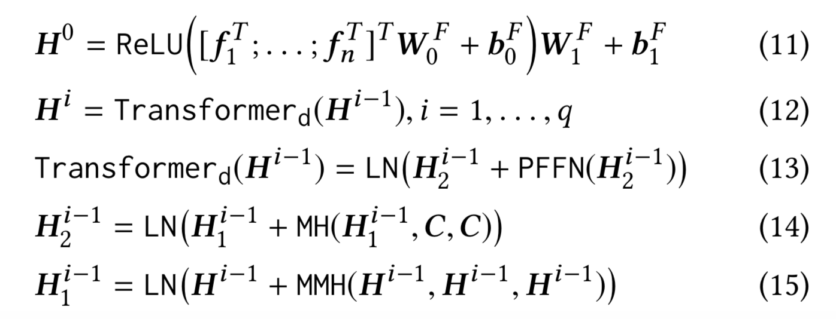
Step 3 ：POG: Personalized Outfit Generation Model
Gen网络使用预训练的FOM初始化
个性化信息
Masked Multi-Head self-attention (MMH)
Notes:
MMH的作用是防止训练时特征穿越，预估当前item利用了未来item的信息

Slide 15
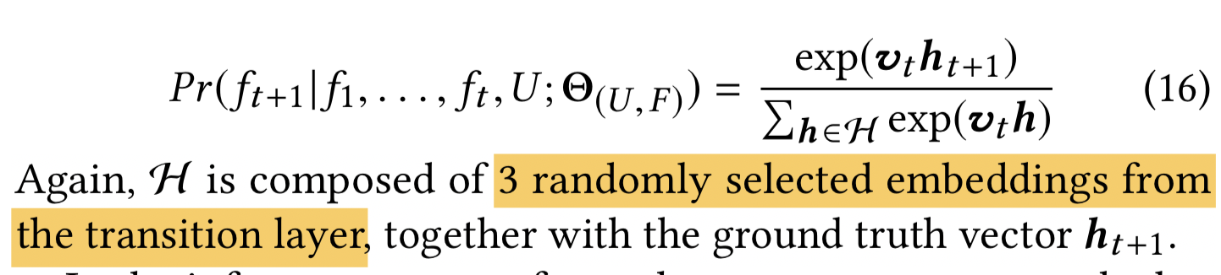
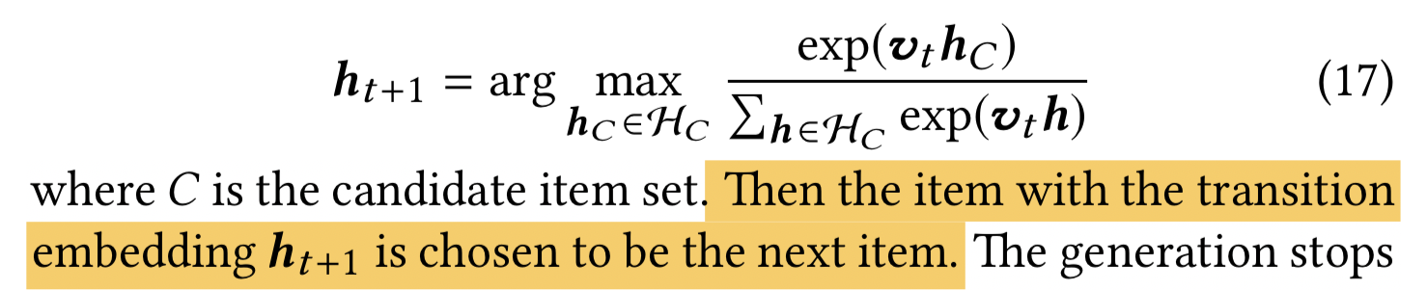
Step 3 ：POG: Personalized Outfit Generation Model
At each step, the model is auto-regressive consuming the previously generated items as input.
one training sample： one clicked outfit ； several clicked items from the same user
ground truth prediction ：items in the outfit
h_{t +1} ：第t个输出Vt的ground truth transition vector
相似性搜索：

Slide 16
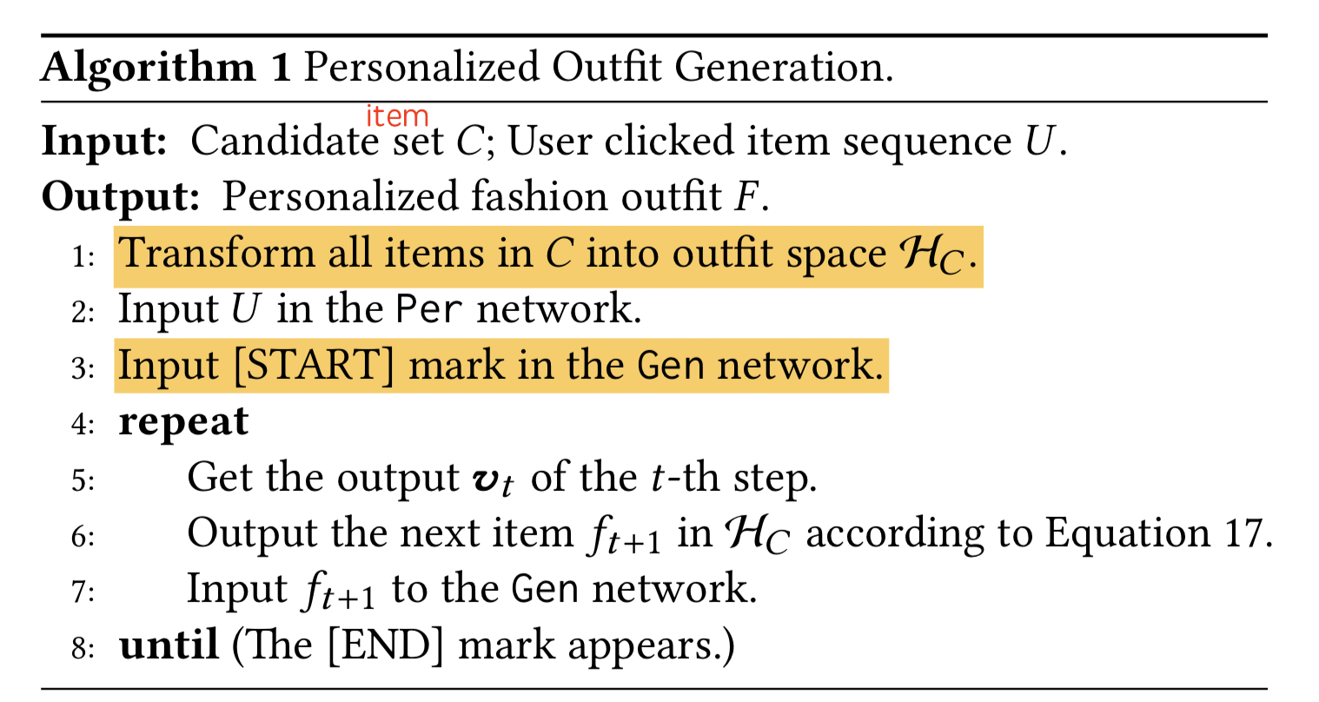
Step 3 ：POG: Personalized Outfit Generation Model

Slide 17
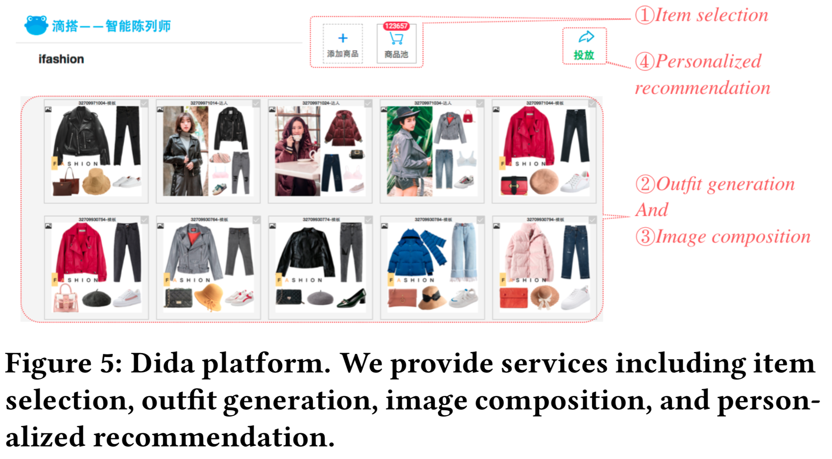
Dida Platform
按照一定规则限制相似性搜索

Slide 18
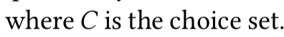
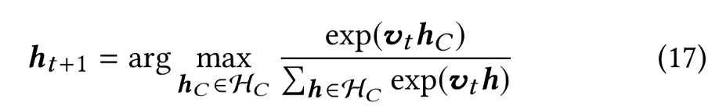
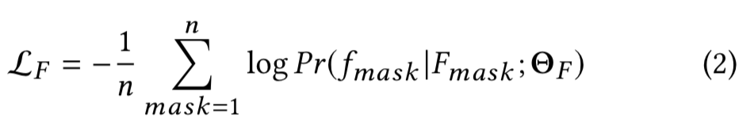
Fashion Outfit Compatibility
Fill In the Blank (FITB) （accuracy）
Compatibility Prediction (CP) ： predict whether a candidate outfit is compatible or not （AUC)

Slide 19
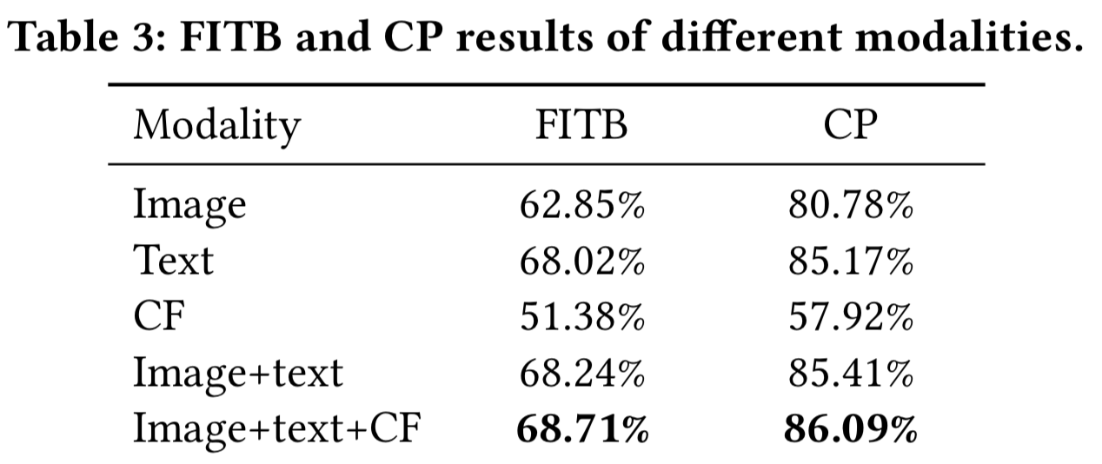
Fashion Outfit Compatibility -Compare Different Modalities

Slide 20
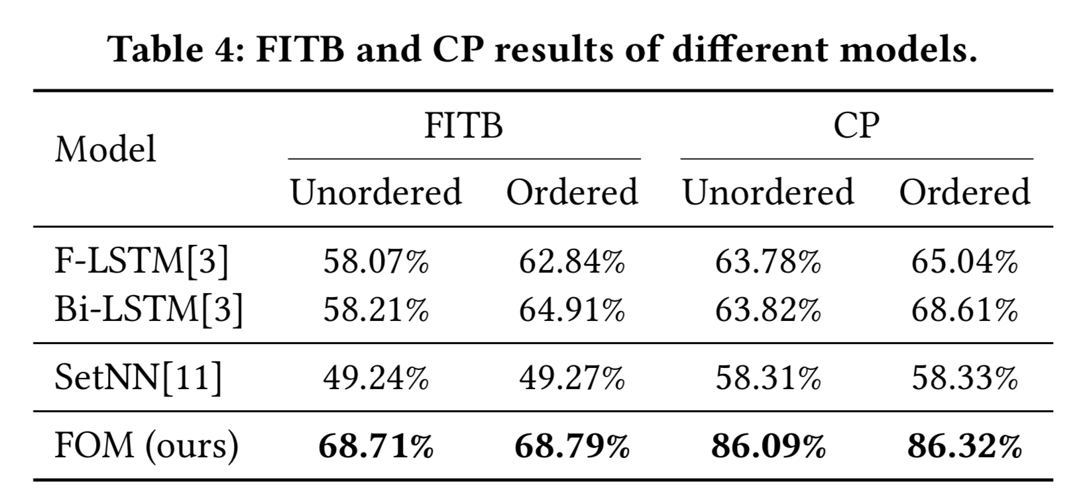
Fashion Outfit Compatibility -Compare Different Models.
基于序列的模型对输入顺序更敏感
双向LSTM比单向好
FOM最好

Slide 21
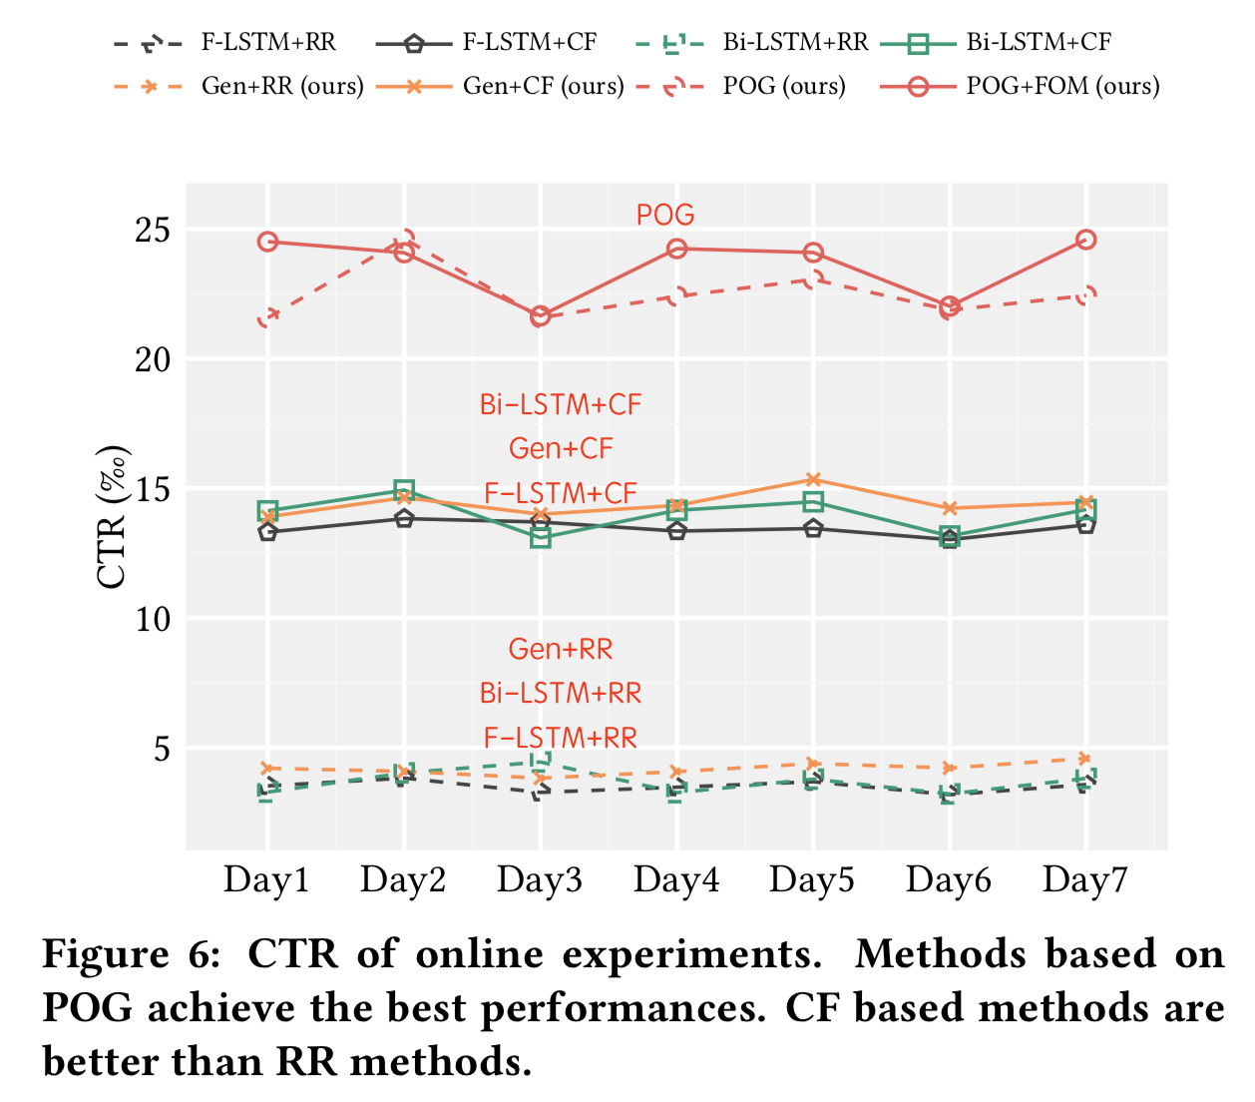
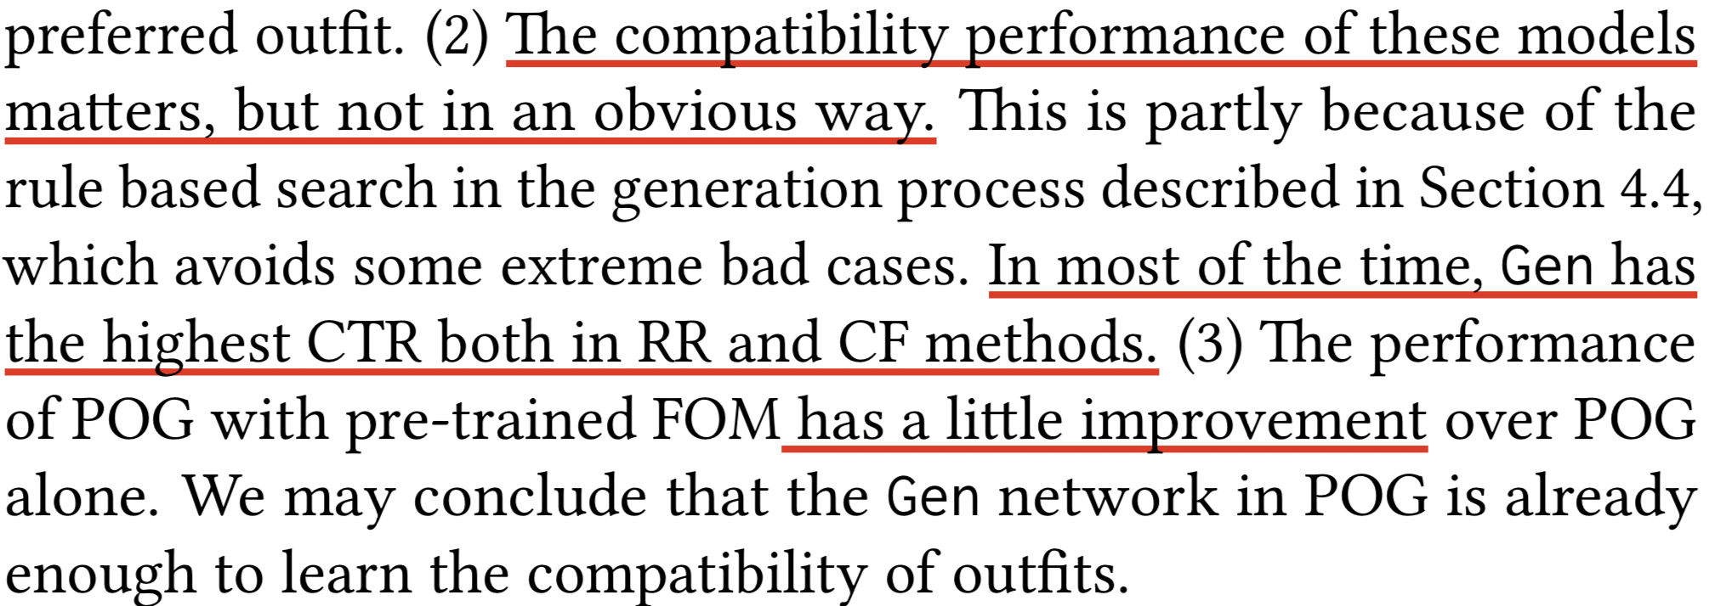
Fashion Outfit Generation and Recommendation
（1）现存的生成模型无法进行个性化推荐。用户最喜欢的item不表示用户最喜欢的outfit

Slide 22
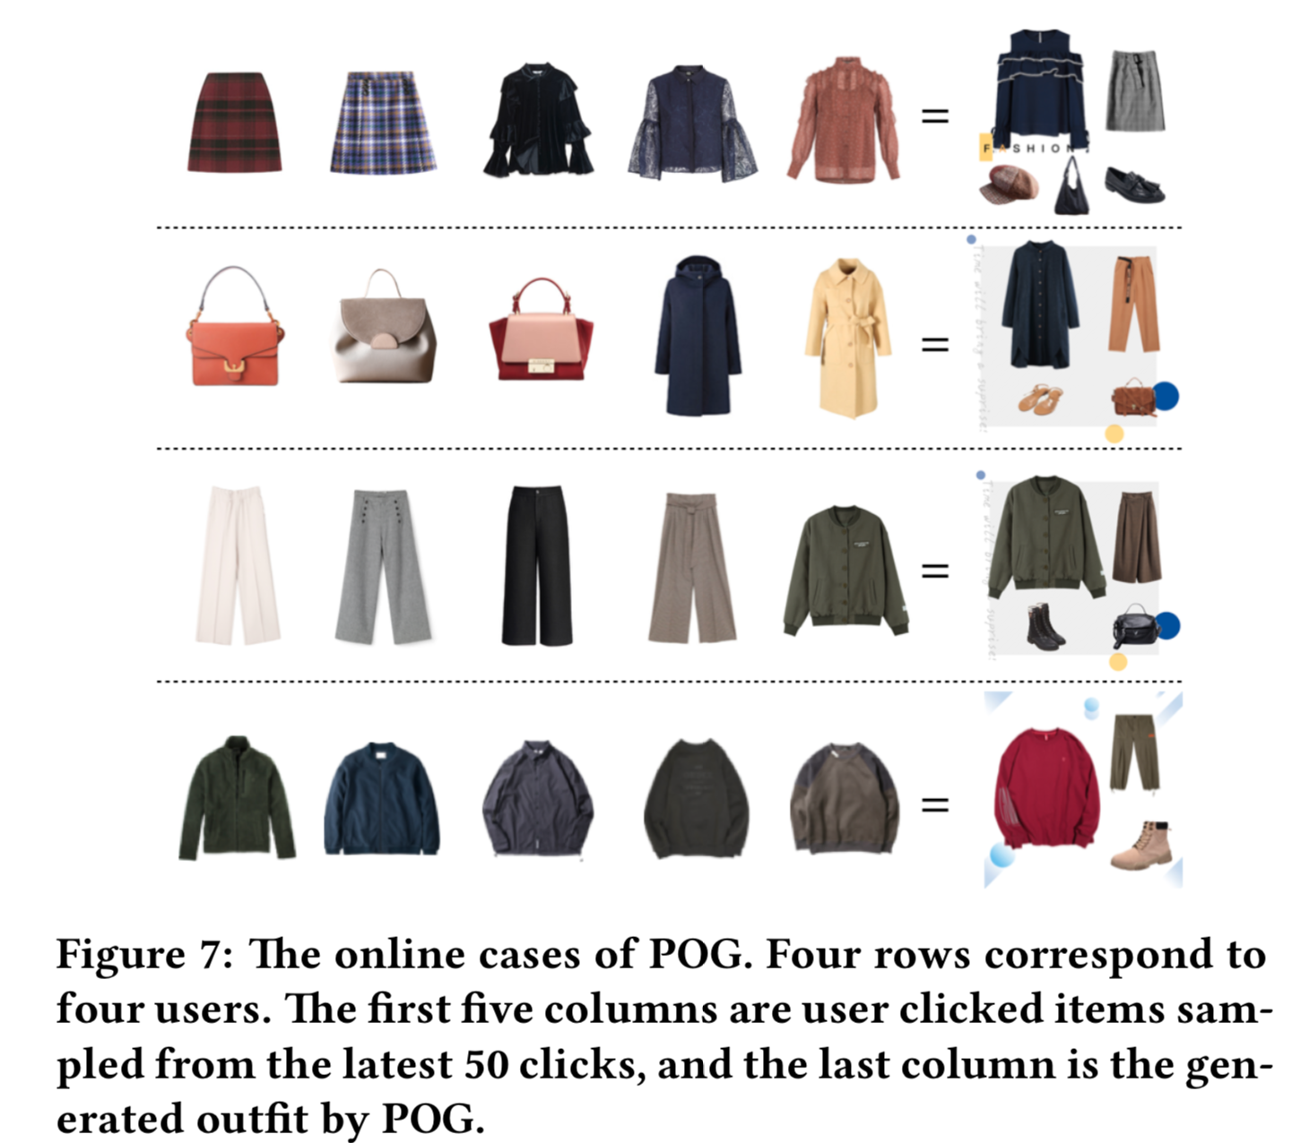
Case Study
For users with various preferences on the items
For users who clicked a lot of similar items

